Slide 1
Gun violence in the u.s.
اعداد : عبدالله الربيعي جمعه المهدي زياده

Slide 2
Comprehensive record of over 260k US gun violence incidents from 2013-2018

Slide 3
This project is for how lives in the US and wants to change living address, and for those who lives overseas and wants to live in the US, to look for a safe place to live in.

Slide 4
steps

Slide 5
1 – exploring the data
Looking for missing data , inappropriate column type.

Slide 6
2 – converting columns with wrong datatype into Appropriate one
Like the date column

Slide 7
3 – dealing with missing data
Filling the missing data using KNNImputer, and Simple Imputer, and the fillna function

Slide 8
4 – dropping unnecessary columns

Slide 9
5 -Visualizing the data

Slide 10
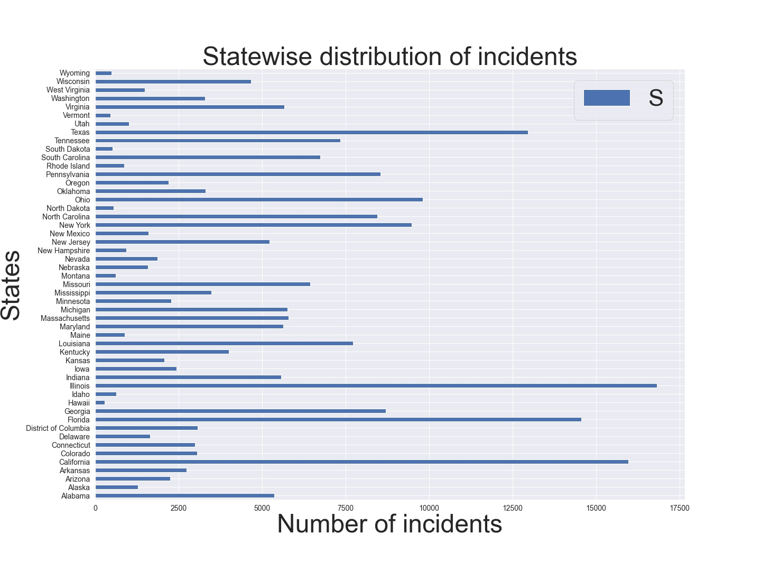

Slide 11
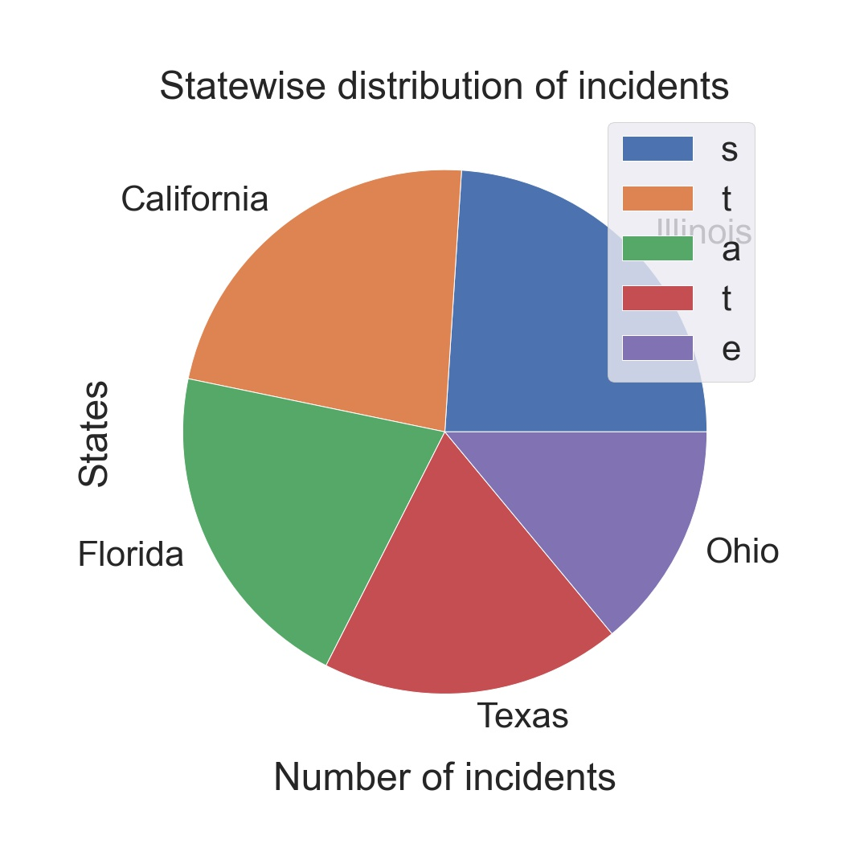

Slide 12
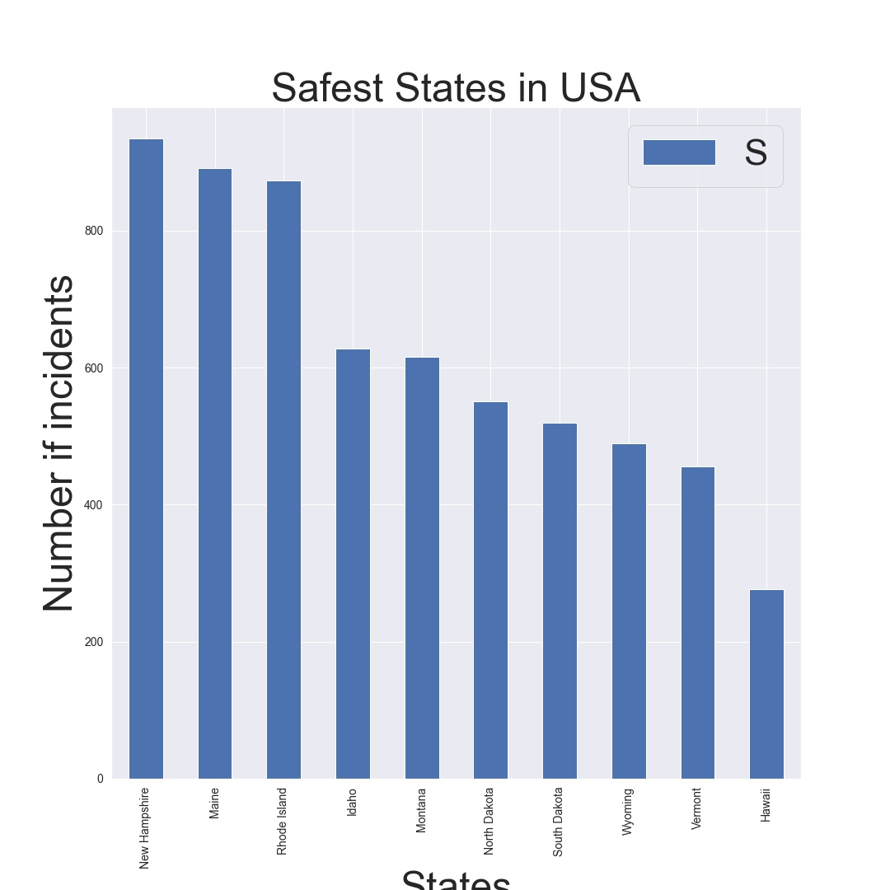

Slide 13
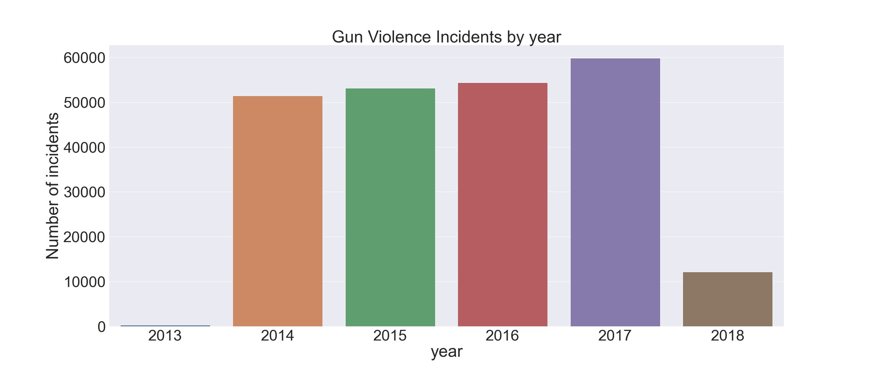

Slide 14
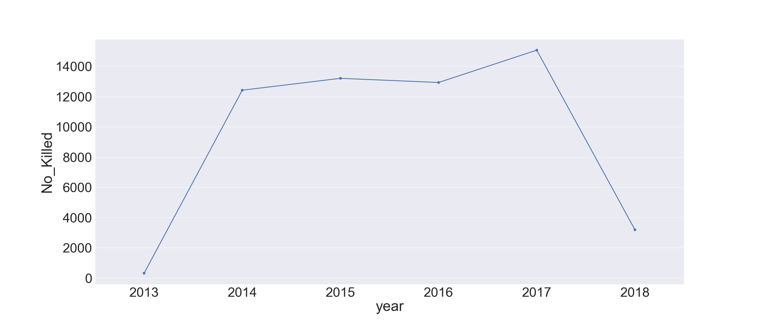

Slide 15
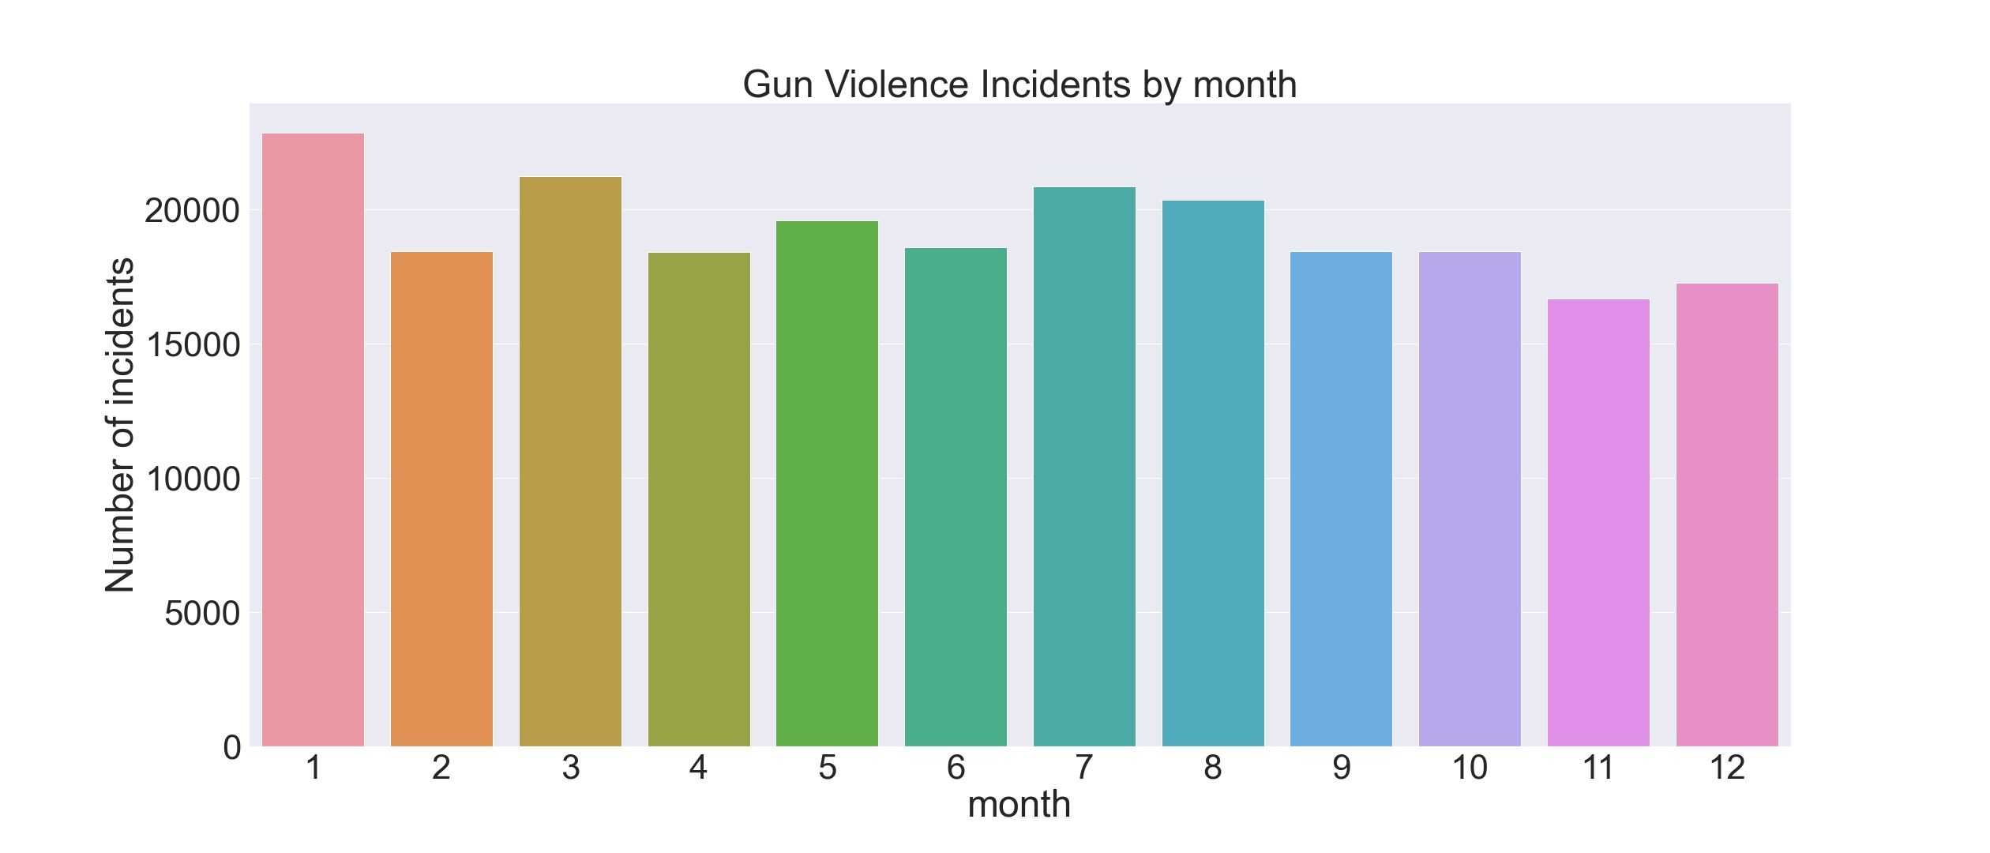

Slide 16
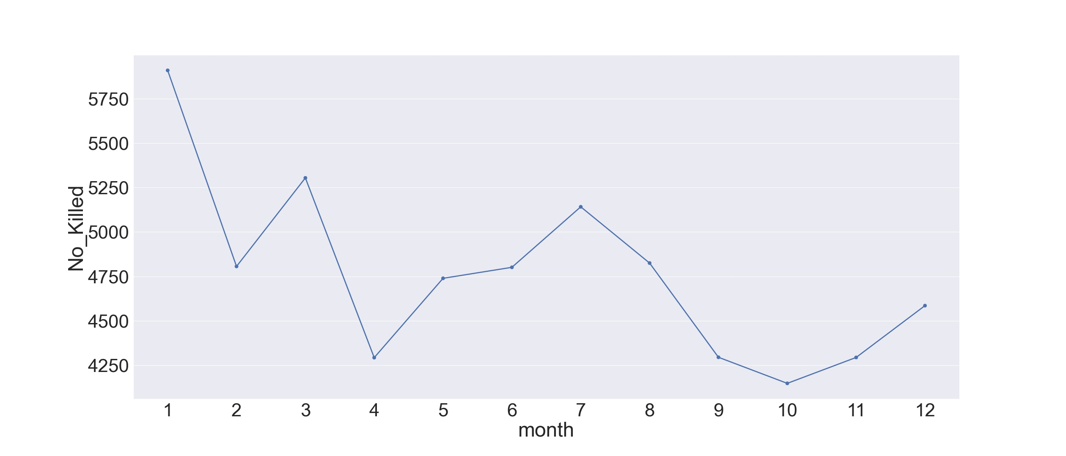

Slide 17
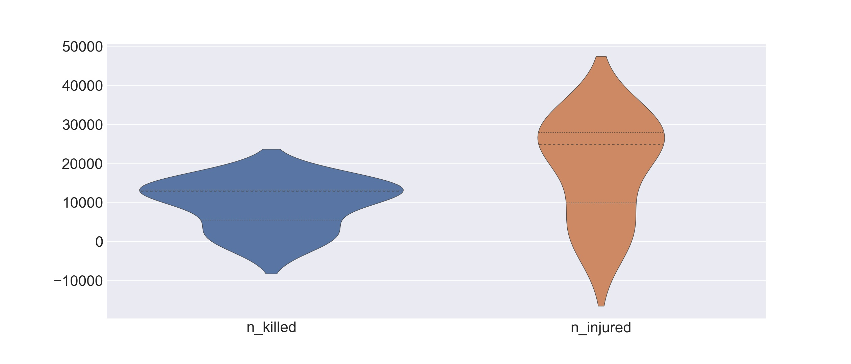

Slide 18
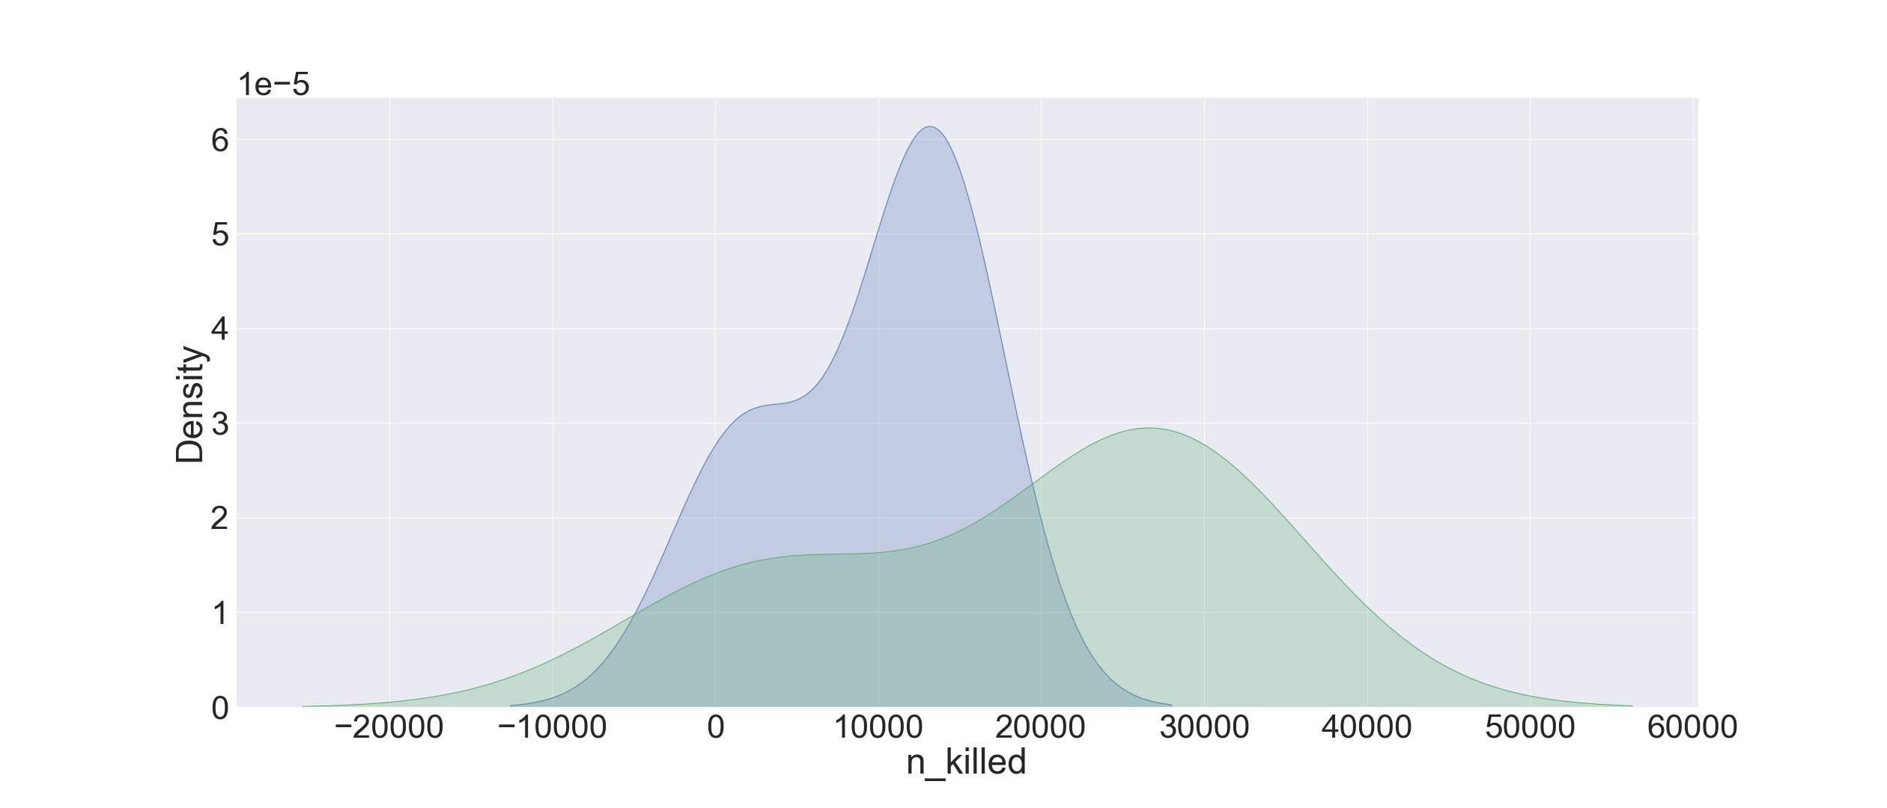

Slide 19
Conclusion

Slide 20
Most injured Year - 2017
Least injured Year - 2013
Most injured Month- January
Least injured Month- Feburary

Slide 21
Top Three Dangerous State llinois California Florida
Top Three Safe State Hawaii Vermont Wyomin

Slide 22
Number of Guns Used :
2 Guns - 59% 5+ Guns - 18.2% 3 Guns- 15.9% 4 Guns - 6.87% Top Three Gun Types recorded
Unknown Handgun Auto / Rifile

Slide 23
Recommendation

Slide 24
Those who would love to change there home location , or want to live in the usa should consider staying away form Illinois, California and Florida; and should be carful during January

Slide 25
Thank you

